Slide 1
Computer Peripherals and Interfacing
Lecture-5
Tumpa Rani Shaha
Assistant Professor, Dept of CSE
BSMRSTU

Slide 2
8257- Direct Memory Access Controller(DMA Controller )
It has 4 channel which can be used over 4 I/O devices
Each channel has 16 bit add and 14 bit counter
Each channel can transfer data up to 64KB
Each channel can be programmed independently
Each channel can perform read transfer, write transfer and verify transfer operation.
It generates MARK signal to the peripheral device that 128 bytes have been transferred.
It operates in 2 modes i. Master mode ii. Slave mode

Slide 3
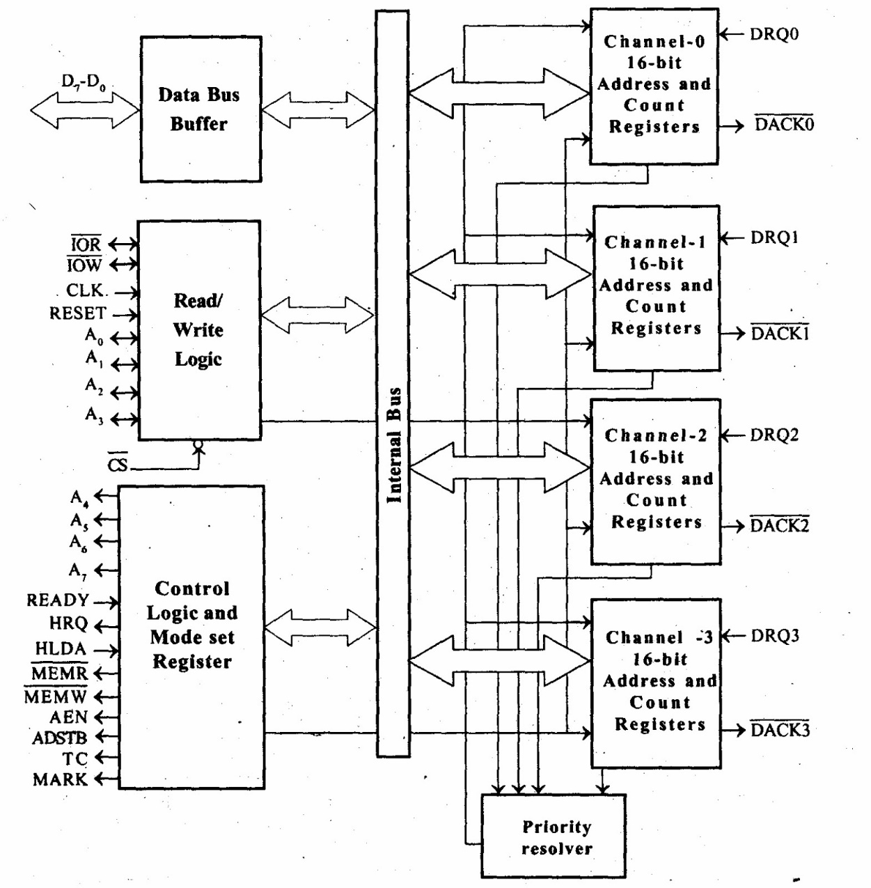
DMA controller

